Slide 1
Graphic Designers Hub

Slide 2
Introduction
In today’s world of growing business and entrepreneurship, everyone needs a graphic designer, but approaching a appropriate graphic designer was not that easy as there is no such valid platform.
The project will also reduce the customers efforts to search a desirable and affordable graphic designer for his business.

Slide 3
Objective and Scope of Project:
The objective of project is to reduce marketing efforts of graphic designers by providing this platform. Also, time and efforts of clients are reduced as they can find designer according to their requirements at one place and also can have choice among number of designers and can filter them according to their prices.

Slide 4
Modules description:-
We basically have 3 different modules in our project namely :
Designer
Order
User

Slide 5
Designer
Designer is the one who is the core part of the project.
He creates his account, login and hosts his work on then site so that users(clients) can see that.
He has his own reviews ,experience and ratings (given by user) on which he is classified.
There are also various types of designers viz typography ,logo designers , calligraphy designers etc.

Slide 6
User
User is the entity who can create an account and login and access the designers and choose his desired designer according to his needs and the ratings and experience.

Slide 7
Order
Order is the module in which the user place order and designer accepts the order.
The respective data is stored in order table f rom which designer and user both can access their respective data.

Slide 8
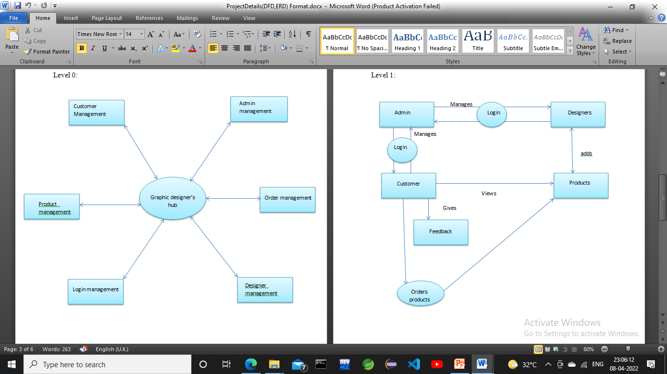
Data flow diagram(DFD)

Slide 9
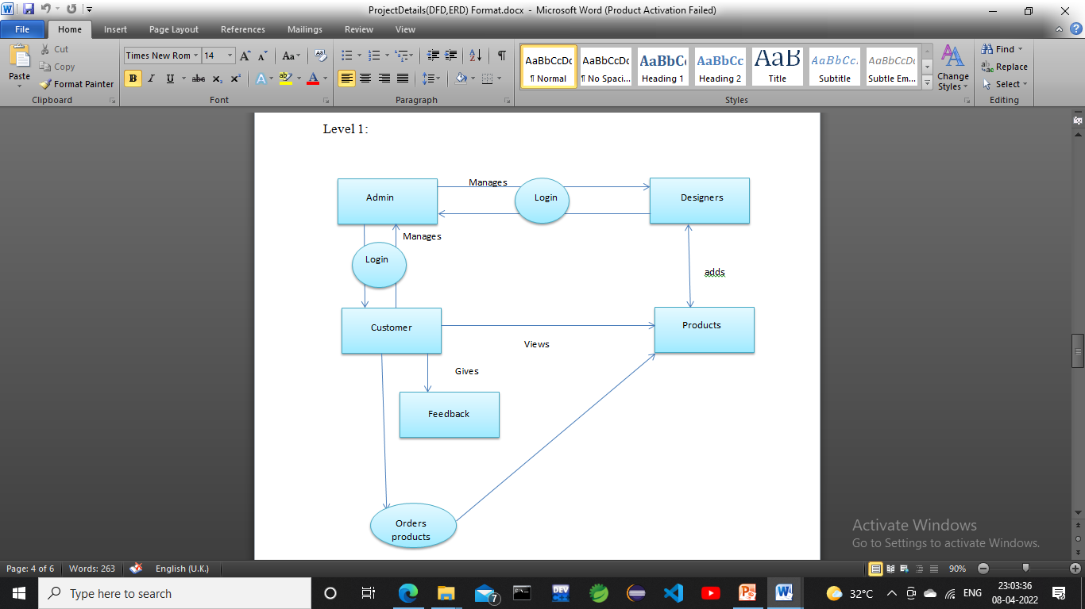
Data flow diagram(DFD)

Slide 10
Future scope
We can let the other website owner to let us promote their work if they are unable to reach the consumers. And we will make sure that the world sees their projects and buys them.
Some designers and artists also make some random digital arts or normal sketch etc. we can make a platform for them to sell their artwork at fair price in future.
Anyone can use this platform to sell their Artworks in future.
We can provide basic templates, so that people who wish to prepare logo or pamphlet which is not for a very important purpose can use these basic themes and design their artwork on their own.

Slide 11
Thank you…

